Slide 1
Html/html5 – Step 3

Slide 2
Hypertext mark up language
HTML is use to create the web page.
The web page can be static and dynamic.
HTML provided lot of pre defined tags or elements which help to create the web page.
HTML version start from 1.0, 2.0, 3.0, 4.0 and 5.0 etc

Slide 3
Html tags
Html
Head
Body
P
heading
Hyper link
Img
Table
Forms

Slide 4
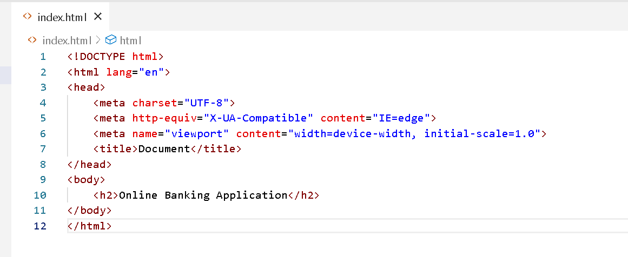
Simple index.html page

Slide 5
Must be create all required web pages
index.html : which contains landing page with menu options
Login form, signUp page, about us, contact us, offer etc
managerDashboard.html :
This page contains menu options as View All customer details, approved or reject to create account, lock account, search account details using emailed or phone number or accno number.
customerDashboard.html :
View account details, transfer amount, check balance, withdraw, deposit, ask special interest base upon condition etc.

Slide 6
End of the html/html5 we expect
We expect all participants must be created all required html pages base upon user storied written using agile.
All html pages connect using hyperlink or button.
Forms require for all html pages base upon type of web page.
Display static data on web pages.

